Slide 1
San Luis Obispo County, CA
Travel Management Coordination Center (TMCC)
Federal Transit Administration
Mobility Services for All Americans (MSAA) Initiative
January 2016

Slide 2
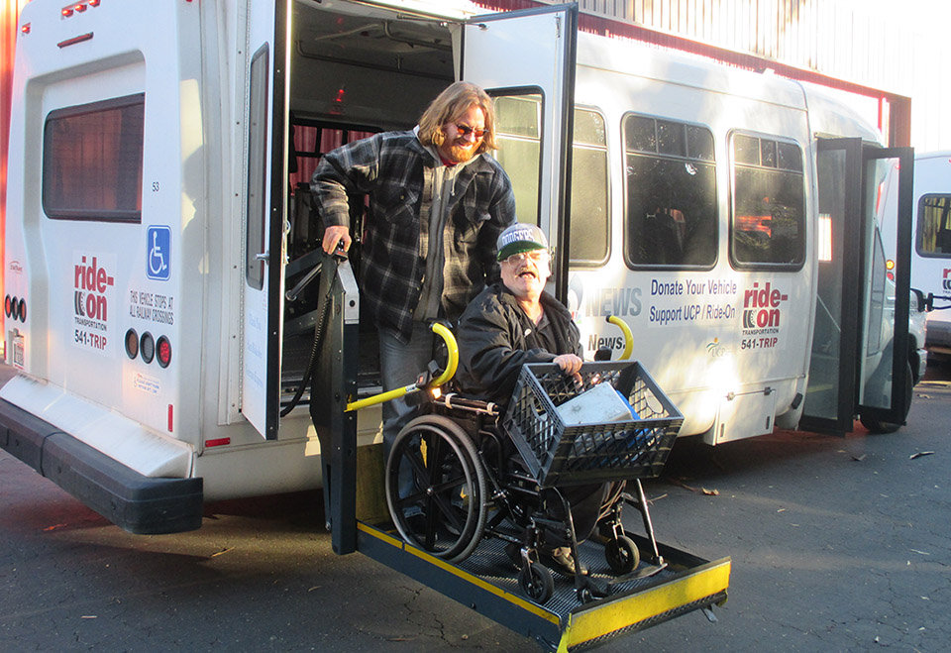
San Luis Obispo County TMCC/MSAA Project
Project Focus
To design an interoperable, replicable, and scalable mobile technology system with the goal of coordinating Paratransit passenger trips among partnering community transportation agencies and sharing this service information in real-time with the public.

Slide 3
San Luis Obispo County TMCC/MSAA Project
Project Partners
United Cerebral Palsy of San Luis Obispo County/ Ride-On Transportation
San Luis Obispo Regional Transit Authority (RTA)
San Luis Obispo Council of Governments
RouteMatch Software
Community Health Centers
San Luis Obispo Regional Rideshare
San Luis Obispo Safe Ride
Local Taxi/Shuttle Service Providers
Local Human Service Agencies

Slide 4
San Luis Obispo County TMCC/MSAA Project
TMCC Advisory Committee Stakeholders
United States Department of Transportation (USDOT), Federal Transit Administration (FTA)
California Department of Transportation (CalTrans)
City of San Luis Obispo (SLO Transit)
CenCal Health (Medi-Cal)
Cal Poly State University – San Luis Obispo
United States Department of Veterans Affairs
USDOT/Federal Highway Administration (FHWA)
Amtrak
Others as appropriate

Slide 5
San Luis Obispo County TMCC/MSAA Project
TMCC Project - Overview
Purpose: Coordinate regional paratransit services through use of Intelligent Transportation Systems (ITS) technology.
Leverage: Utilize the ITS Systems Engineering and stakeholder planning processes to design and develop a scalable and replicable TMCC.
Project Duration: 18 months
Expected Outcomes:
(1) Explore all local Partners’ institutional barriers to regional paratransit coordination.
(2) Seek a common solution to leverage ITS to identify opportunities to link Partner databases and services in real-time while providing immediate information to customers.
(3) Create a detailed set of system design documents on how to build, fund, and sustain the TMCC.
(4) Receive planning guidance on how to address any observed institutional coordination barriers.
(5) Demonstration of a Common Fleet Information Platform (TMCC).*
(6) Inter-agency paratransit coordination and increased customer mobility.
(7) Provide all deliverables to FTA as requested in a timely manner.
*MSAA funding does not include implementation and deployment in support of the TMCC.

Slide 6
San Luis Obispo County TMCC/MSAA Project
TMCC Project – Deliverables and Timeframe
Deliverable | Timeframe
Deliverable #1: Create a Detailed Project Plan & Schedule Document | November 2015 - January 2016
Deliverable #2: Create the TMCC Concept of Operations Document (what is the TMCC and issues impacting its development) | January – April 2016
Deliverable #3: Develop the TMCC System Requirements Document (TMCC operation and technology expectations) | May – June 2016
Deliverable #4: Create the TMCC High Level System Design Document (explore, evaluate, and determine TMCC alternatives – select preferred design) | July – August, 2016
Deliverable #5: Prepare the TMCC Phased Implementation Plan Document (Formalize a task and timeline plan for implementing the TMCC) | September – October 2016
Deliverable #6: Common Fleet Information Platform (Final detailed design (prototype) and test plan for the technology elements of the TMCC) | October 2016 – June 2017

Slide 7
San Luis Obispo County TMCC/MSAA Project
TMCC Project – Deliverables and Timeframe, continued
Deliverable | Timeframe
Deliverable #7: Prepare Draft Final Report & Briefings (submit final project report to FTA and provide briefings as needed) | October 2015 - June 2017
Other Deliverables/Meetings: Project Management team meetings. Attend required FTA meetings, including national events. Hold quarterly TMCC Advisory Committee meetings. Hold Public Forums (2) - March and fall 2016. Project Staff: Ride-On and RouteMatch Software. | October 2015 – June 2017
Oversight Review & FTA Reports Project management and oversight (Ride-On and RTA). Ensure that all Deliverable reports are submitted to FTA for review/approval. Complete FTA monthly and quarterly project reports. | September 2015 – January 2017

Slide 8
San Luis Obispo County, CA
Travel Management Coordination Center (TMCC)
Federal Transit Administration
Mobility Services for All Americans (MSAA) Initiative
January 2016

Slide 9
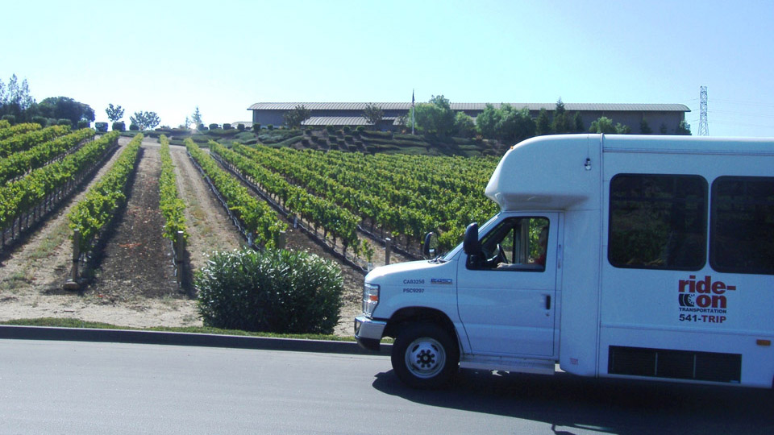
San Luis Obispo County TMCC/MSAA Project
What is a TMCC?
USDOT Generic Definition:
“…provides one-stop, unified customer-based travel information and trip planning services, and supports coordinated human services transportation operations.” ¹
(1) Source: USDOT - http://www.its.dot.gov/msaa/TMCC_ConOps.htm#sthash.3JtlWNRO.dpuf

Slide 10
San Luis Obispo County TMCC/MSAA Project
What is a TMCC?
It is:
People focused.
Mobility enabling.
Partnership oriented.
Community determined.
Technology inclusive.
Yours to design!
It may include…
Multiple provider partners.
Operational collaboration.
Service coordination.
One-Call/One-Click Center.
In-person mobility services.
Telephone-based mobility services.
Internet and mobile services.
Information & Referral.
Inter-agency agreements.
Technology enabling.
Travel training.
Maintenance agreements.
Other items of interest.

Slide 11
San Luis Obispo County TMCC/MSAA Project
What is a TMCC? An example…
Consumer with Mobility Needs
U.S. State & Local Government Funds, Policies, and Regulations
Employment
Health Care
Independence
Family
Education
Recreation
One Call
Funding Agencies
Public
Transit
Authority
ADA
Para-
transit
Medical
Transit
Provider
Faith
Based
Transit
Head
Start
Agency
on
Aging
Transit
Pass
Disability
Service
Provider
Private
Taxi
Transportation
Interior
Social
Security
Housing
Veterans
Affairs
Agriculture
HHS
Labor
Education
Transportation Service Providers
Courtesy: USDOT

Slide 12
San Luis Obispo County TMCC/MSAA Project
What is a TMCC?
Questions for Committee Feedback:
What do you consider a TMCC?
How could a TMCC improve transportation for your organization/business?
What barriers do you see to implementing a successful TMCC?
How will the TMCC benefit the transportation user?
How could a TMCC improve the current transportation delivery system?

Slide 13
San Luis Obispo County TMCC/MSAA Project
Questions and Comments
Project Contacts:
Mark Shaffer, Project Manager, Ride-On Transportation: (805) 541-8751, shafmt@aol.com
Geoff Straw, San Luis Obispo RTA: (805) 781-4465, gstraw@slorta.org
Omar McPherson, San Luis Obispo RTA: (805) 781-1171, omcpherson@slorta.org

